Slide 1
STATUS OF SLIPTA ACTIVITIES IN THE DR CONGO
by
Bizette Bizeti Nsangu, MD, MSc
GLOBAL HEALTH SYSTEMS SOLUTIONS (GHSS)

Slide 2
Outlines
OVERVIEW OF THE PROGRAM
SLIPTA AUDIT PROGRESS IN DR CONGO 2019-2024
EVOLUTION OF THE SLIPTA PROGRAM
SOME CHALLENGES IN THE IMPLEMENTATION OF THE SLIPTA PROGRAM
RECOMMANDATIONS/PERSPECTIVES

Slide 3
Overview of the Program
In DRC the SLIPTA process started in 2018 with a baseline audit in 6 laboratories in Kinshasa
Baseline audit in 6 laboratories
Training of national auditors
Mentorship of 6 laboratories
The following year in 2019, extension of the program to 12 additional laboratories (8 in Kinshasa, 3 in Haut-Katanga and 1 in Lualaba).

Slide 4
SLIPTA Audit Program Coverage in DR CONGO, 2019-2024
o |  | NUMBER OF AUDITS |  |  |  |  |  |  | TRAININGS RECEIVED
S/N | Names of Laboratories | 2019 | 2020 | 2021 | 2022 | 2023 | 2024 | TOTAL | SLMTA (1&2) | Internal audits | IQC/Root CAUSE | METHOD VALIDATION | SLIPTA STATUTS
1 | DREAM KIN LAB | 1 | 2 | 0 | 1 | 1 | N/A | 5 | 4 | 1 | 1 | 0 | 2 STARS
2 | LNRS KIN | 1 | 2 | 0 | 1 | 0 | 1 | 5 | 0 | 1 | 1 | 0 | 0 STAR
3 | CUL L'SHI | 0 | 1 | 1 | 1 | 1 | N/A | 4 | 6 | 3 | 3 | 0 | 1 STAR
4 | CNTS / PNTS | 1 | 1 | 0 | 0 | 0 | N/A | 2 | 0 | 1 | 1 | 0 | 0 STAR
5 | HMC KOKOLO | 0 | 1 | 0 | 0 | N/A | N/A | 1 | 5 | 1 | 1 | 0 | 0 STAR
6 | H. BIAMBA MM | 0 | 1 | 0 | 0 | N/A | N/A | 1 | 5 | 1 | 1 | 0 | 0 STAR
7 | LNRM / PNLT | 0 | 1 | 1 | 0 | 1 | N/A | 3 | 4 | 1 | 1 | 0 | 1 STAR
8 | CHME MONKOLE | 0 | 1 | 1 | 0 | 1 | N/A | 3 | 4 | 2 | 2 | 0 | 3 STARS
9 | HJ HOSPITALS KIN | 0 | 1 | 1 | 0 | 1 | N/A | 3 | 0 | 2 | 2 | 0 | 2 STARS
10 | INRB/PARASILOGIE LAB | 1 | 0 | 1 | 1 | 0 | 1 | 4 | 0 | 1 | 1 | 0 | 1 STAR
11 | CUK BIOMED LAB | 1 | 0 | 1 | 1 | 1 | N/A | 4 | 0 | 1 | 1 | 0 | 1 STAR
12 | HOP PED KLL (KALEMBELEMBE) | 0 | 0 | 1 | 1 | 0 | 1 | 3 | 1 | 1 | 1 | 0 | 0 STAR
13 | CH KINGASANI | 0 | 0 | 1 | 1 | 0 | N/A | 2 | 1 | 1 | 1 | 0 | 0 STAR
14 | LPRS L'SHI | 1 | 0 | 1 | 1 | 1 | N/A | 4 | 5 | 3 | 3 | 0 | 1 STAR
15 | Jason SENDWE L'SHI | 0 | 0 | 1 | 1 | 0 | N/A | 2 | 6 | 3 | 3 | 0 | 0 STAR
16 | GECAMINES SUD L'SHI | 0 | 0 | 1 | 1 | 0 | N/A | 2 | 5 | 3 | 2 | 0 | 0 STAR
17 | HOPITAL MWANGEJI KOLWEZI | 0 | 0 | 1 | 1 | 0 | N/A | 2 | 0 | 2 | 0 | 0 | 0 STAR
18 | KCC WATUWETU Kolwezi | 0 | 0 | 1 | 1 | 0 | N/A | 2 | 0 | 2 | 1 | 0 | 0 STAR
 | Legend:
 | N/A: Not Audited

Slide 5
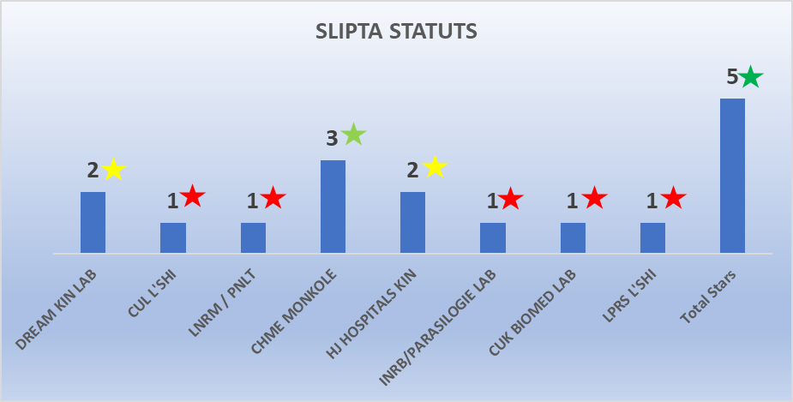
Evolution of SLIPTA Program in DR Congo
SLIPTA lab Statut 2019 to 2024
SLIPTA Lab statut 2024

Slide 6
Challenges in SLIPTA Program Implementation in DR Congo
Weak/absence of laboratory management team commitment in some health facilities
Insufficient resources (mentors) assigned to building the capacity of healthcare staff to implement the SLIPTA program in health facilities.
Some laboratories lack the human resource capacity to sustain QMS gains as such experience a drop
Recurrent MoH human resource strike leading missed opportunities for monitoring improvement plans and for QMS implementation as laboratories are not accessible and personnel unavailable
The unavailability of staff to implement corrective actions in some laboratories is delaying the transition to accreditation.

Slide 7
Actions items/Projections
A. Actions items
Request an active involvement of the Ministry of Health at the highest level to monitor score of improvement projects and QMS implementation in all the enrolled laboratories.
Train more laboratory staff to become increasingly familiar with quality management system activities, to implement the quality management system and thus achieve faster results (SLMTA training, ISO 15189 training in June 2024).
B. Projections
Three Laboratories will be Evaluated in June 2024 by an accreditation body (SADCAS)

Slide 8
Thank you for your attention

